Slide 1

Our challenge………….

Slide 2
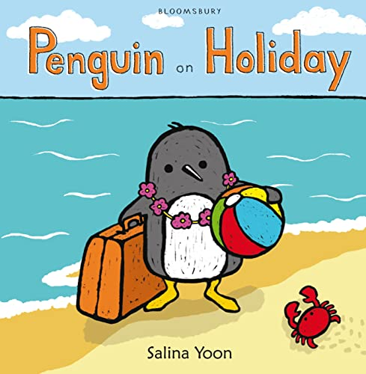

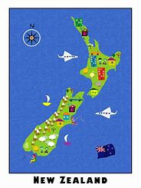
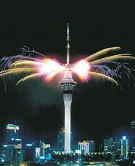
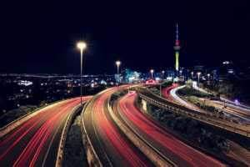
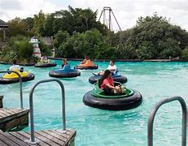
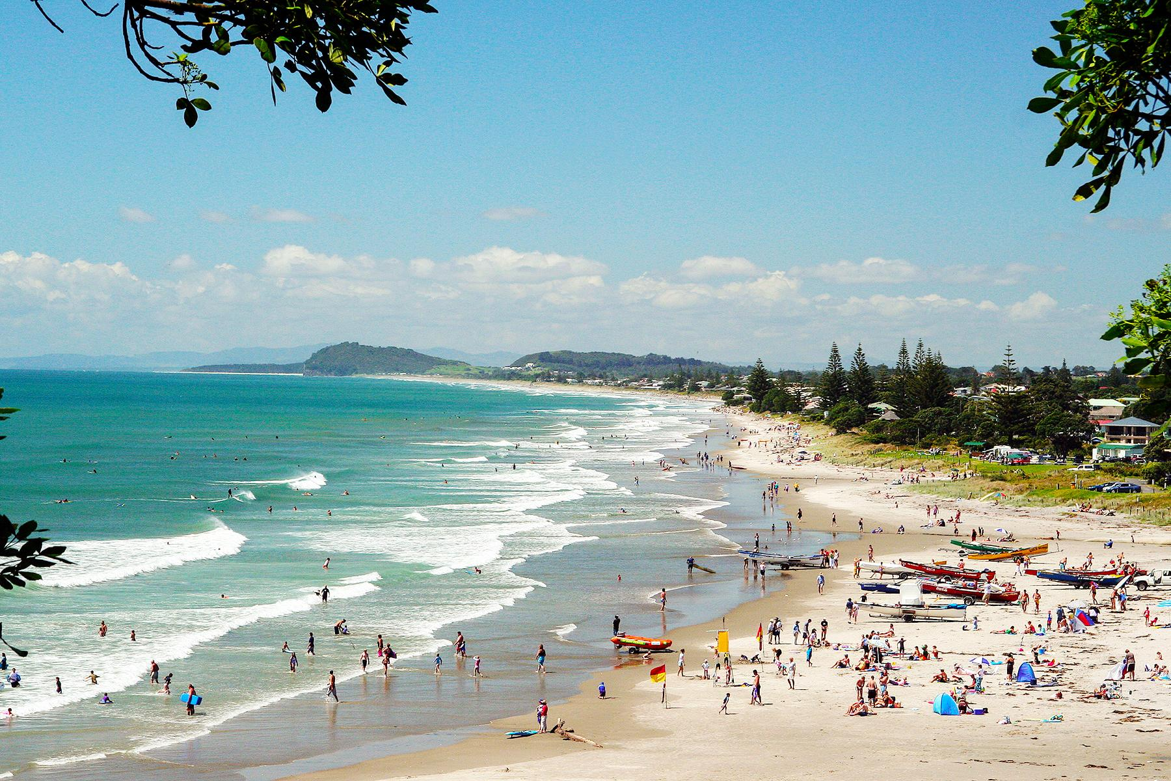
Thank you
Penguin
We think New Zealand is a great place for an amazing holiday because we have learnt so much about it. There is plenty to see and do especially the rich culture and incredible landmarks.

Slide 3
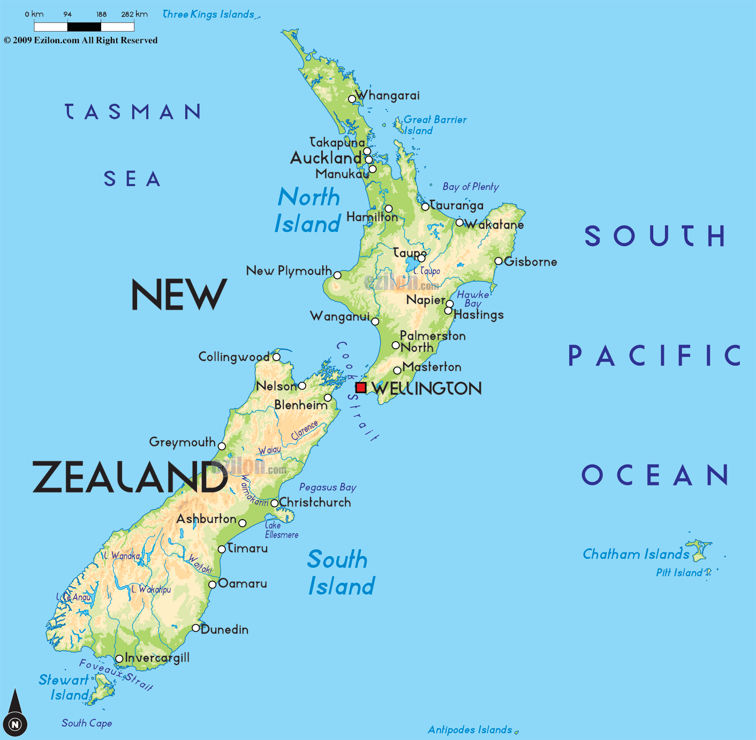
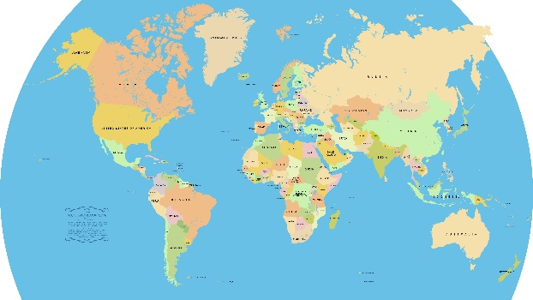
New Zealand is a great holiday!
Have you been to new Zealand ?
Where is New Zealand?
New Zealand is in Oceania.
Did you know that new Zealand have two island north and south island?
New Zealand is in the southern hemisphere.

Slide 4
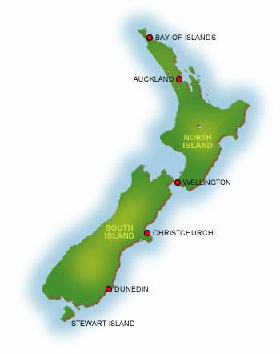
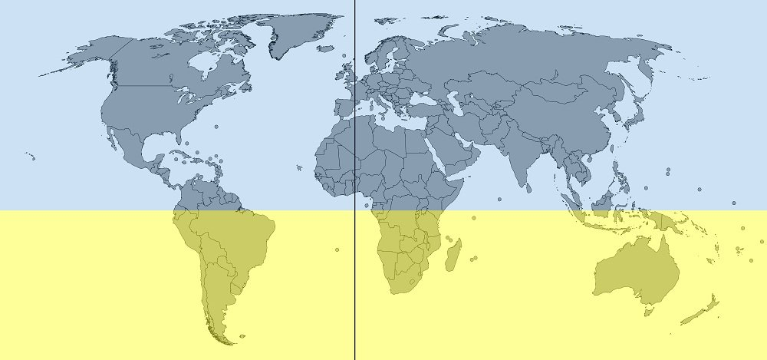
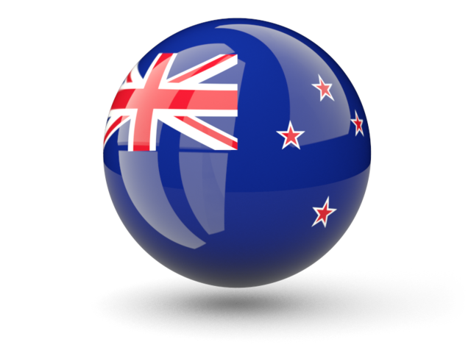
Where is New Zealand?
New Zealand has 2 islands.
New Zealand is in the Southern Hemisphere. It is in Oceania far away from England.
New zealand is in the Pacific Ocean.
24 hours to New Zealand.

Slide 5
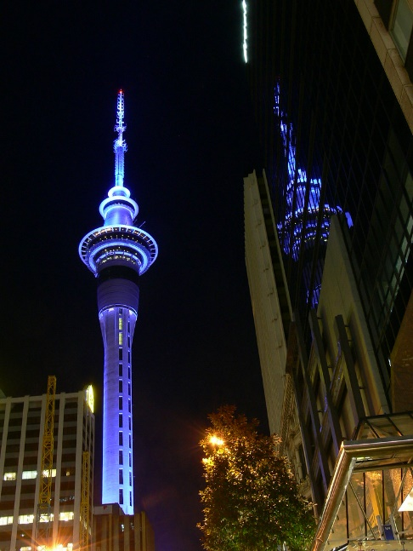
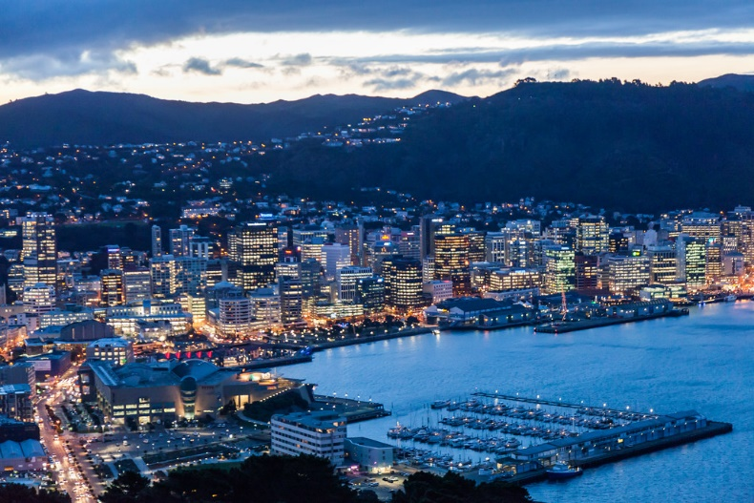

interesting facts
Did you know there was a tall landmark called the skytower?
Did you know there was a permanent building that is called the beehive. It is the parliament?
Did you know wellington has lotsof red cabel cars?
Did you know there are more sheep then people?
Wellington is important because wellington is the capital city of new Zealand.

Slide 6
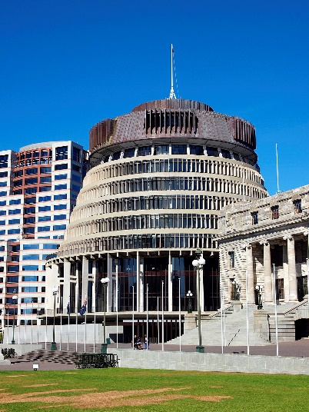
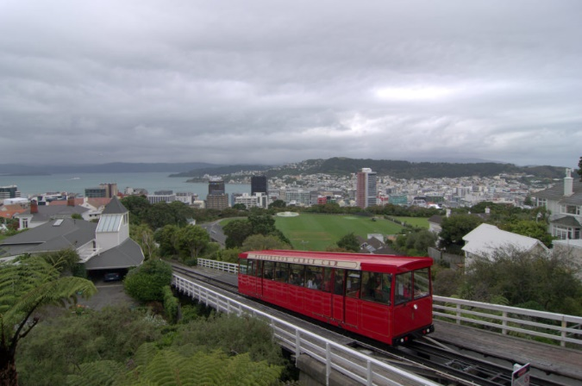
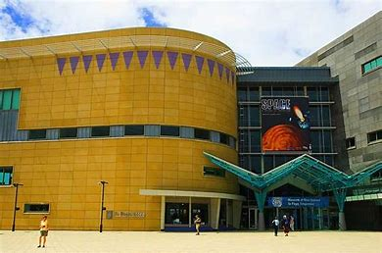
Welcome to Wellington
The beehive is part of the parliment bulding..
Did you know it was not always the capital city of new Zealand?
In Wellington they have red cable cars to take you up the mountains.
The Te Papa museum is the biggest in New Zealand.
Windy wellington!
The capital city of New Zealand.

Slide 7
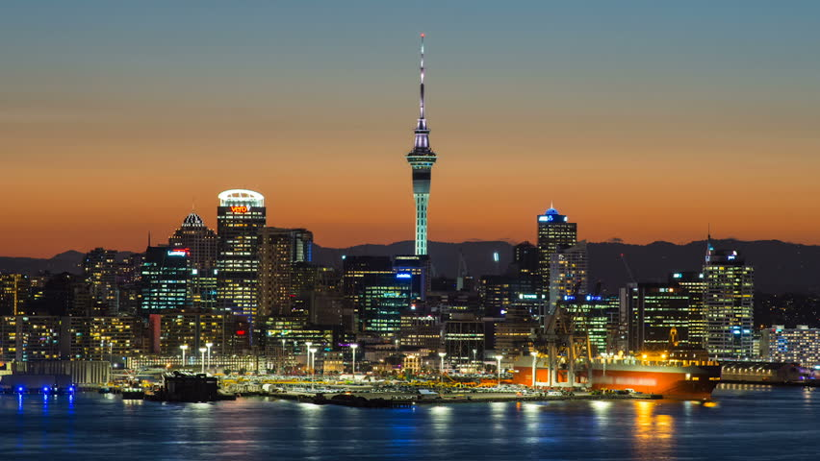
Auckland has a beautiful sky tower.
Auckland has a famous zoo.
Fabulous Auckland
Did you know that Auckland was the capital city first?
Wellington is the capital city of new Zealand now. 400000 people live in wellington.it has a red cable car.
Come to amazing Auckland!
Auckland is in the north isiand it has 50 volcanoes and a beach.
There was a map of New Zealand and it looked like a boat and a fish.

Slide 8
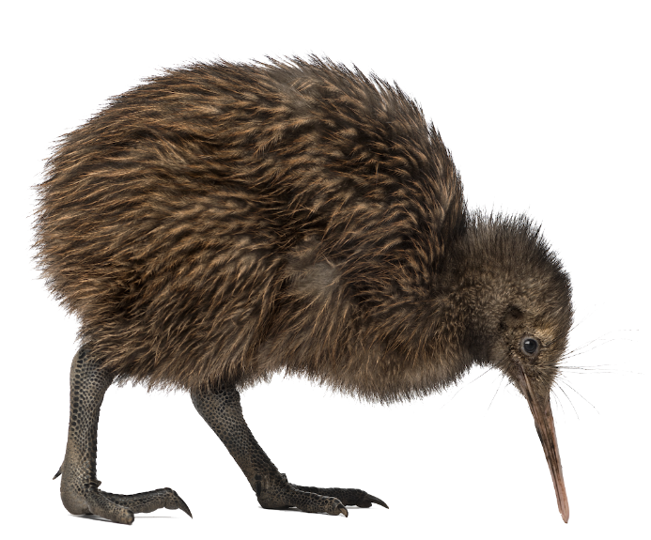
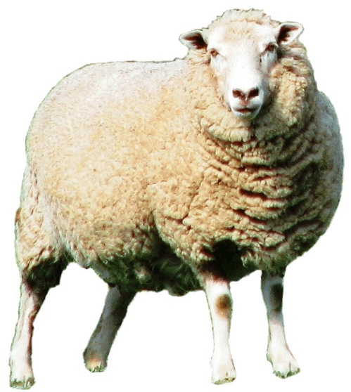
Facts about New Zealand
New Zealand has lots of sheep and kiwi birds.
Did you know kiwi only comes from New Zealand?
Kiwi birds are birds that can not fly and that has a long beeck.

Slide 9
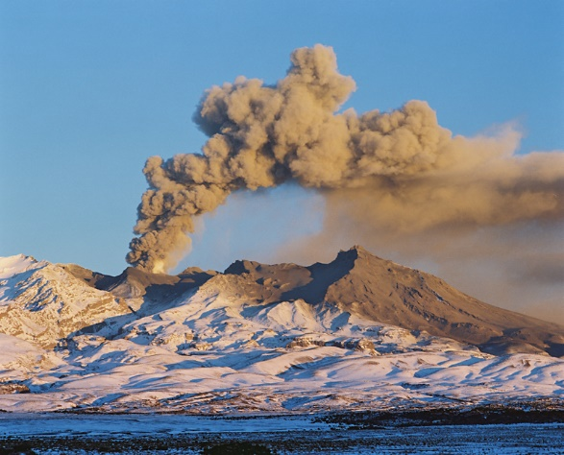
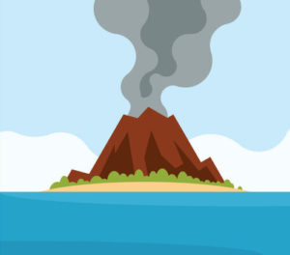
Did you know that there is a Volcano in New Zealand called the Taupo?
Super volcanoes
Volcanoes are mostly found in the ring of fire.
There are 50 volcanoes in New Zealand.
The land around the volcano is excellent for growing crops due to the ash and mud flow.

Slide 10
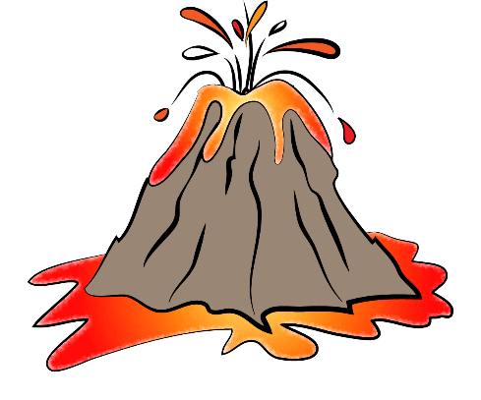
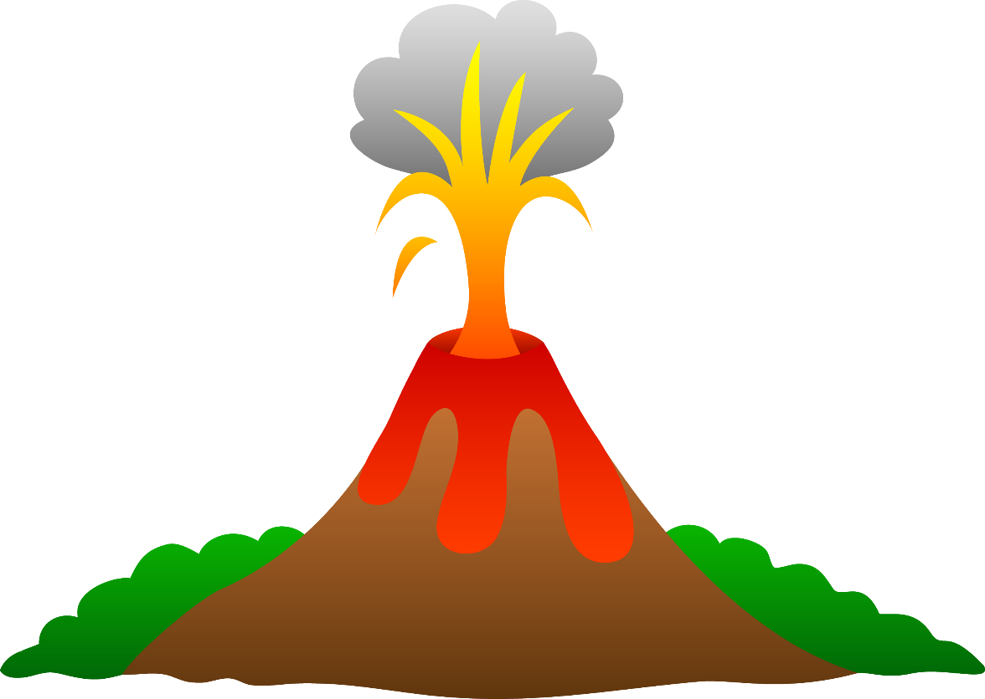
Taupo volcano
It is an active volcano.
It is the biggest volcano in New Zealand..
Watch out hot lava!
Big volcano erupting!
It is a super volcano.

Slide 11

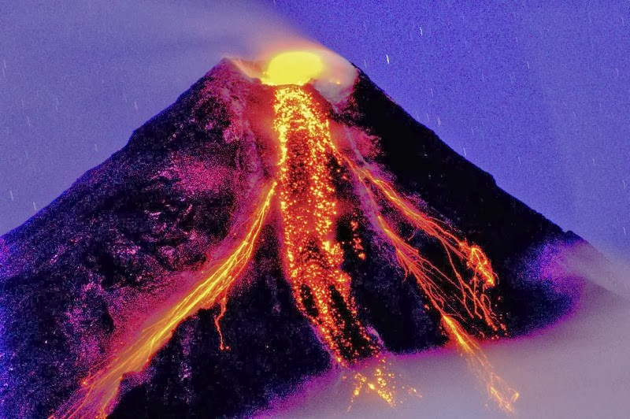
Amazing Volcanoes
Did you know that the volcanos larvar is really really hot?
The larvar is boling hot.
Volcanoes are really dandriss because of the heat.
BEWARE of volcanoes!
Taupo volcano is active and is a SUPERVOLCANO.

Slide 12

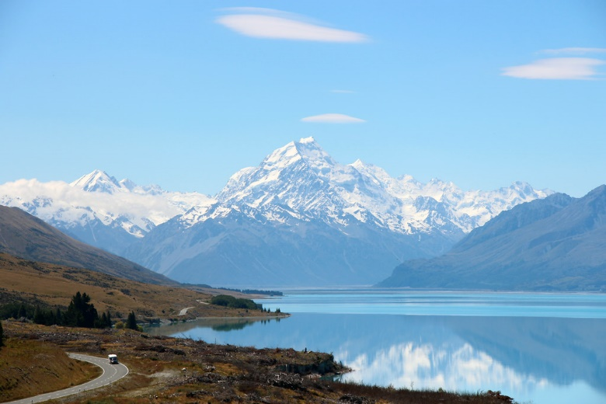
Aoraki mount cook
Mount Cook was called Aoraki because he was turned to stone.
Mount cook is in the south island.
It is 3724m tall. It is New’s Zealnds biggest mountain.
Would you like to climb this mountain?
What an enormous mountain!

Slide 13
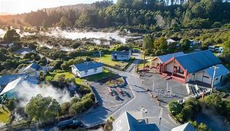
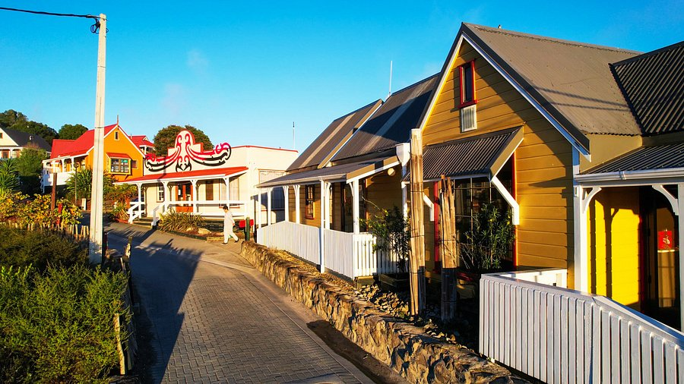
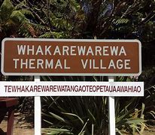
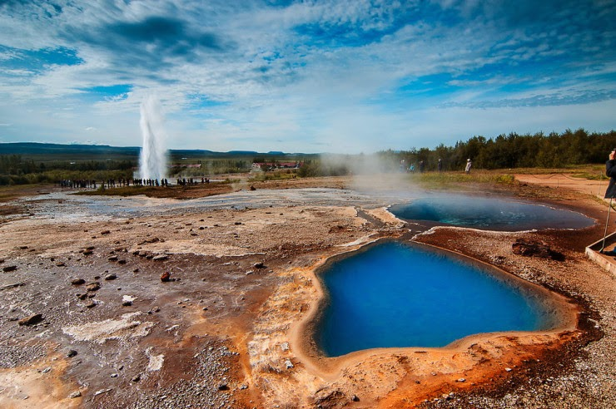
Wakararwera
In Wakararwera there are some amazing grey geysers and bubbling hot springs.
Did you know there are over 5000 hot springs in Wakararwera?
You will have to be careful if you want to go in a hot spring because you might get burnt!
Maori people still live here and cook in the hot springs.

Slide 14
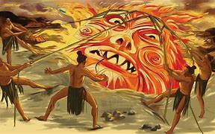
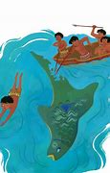
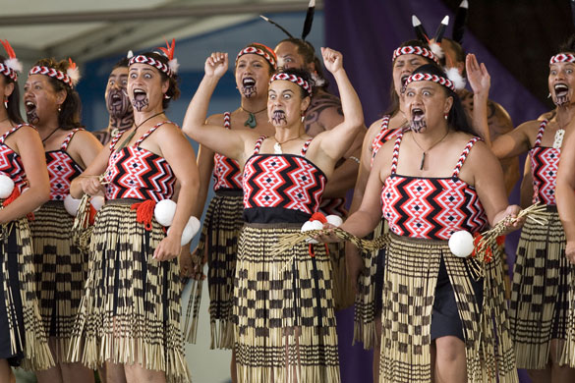
The New Zealand creation story
The fish of maui is the North island and the waka is the South island.
Exploring the Mauri world
The days were so short and no time to do anything people moaned someone has to do something. Maui came along with a plan he had a magic bone [maui touches the sun the sun pulls back in pain] now the days are longer and people can play and go to work.
Did You Know?
The Mauri people have a dance call the haka. It involed loud chanting!!!

Slide 15
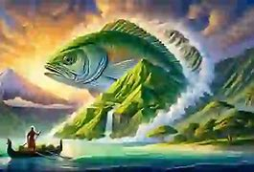
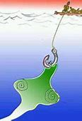

The Amazing Mauri Myths
Did you know there is a majestic myth (well I think its majestic) called Maui tames the sun?
In the fish of maui a canoe turns giant and becomes the south island!
The fish in the fish of Maui becomes the North Island!!

Slide 16

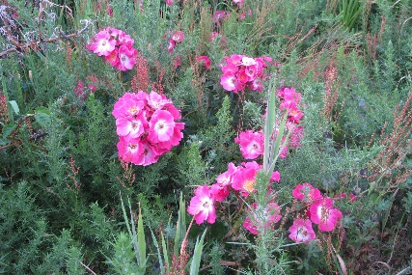

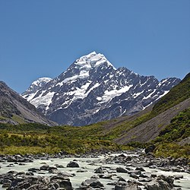
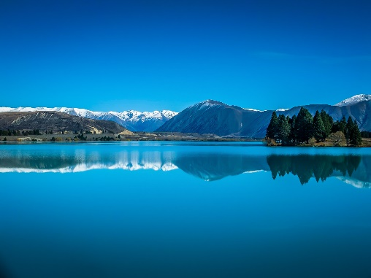
Summer in New Zealand is mostly sunny and up to 32 degrees.
Weather and seasons
Spring in New Zealand has colourful flowers.
Have you seen the weather of New Zealand?
Winter in New Zealand brings snow to the mountain peeks and can get up to 3 degrees.
New Zealand is sometimes really hot and sunny!

Slide 17


Weather seasons
In New Zealand it has the opposite seasons to the UK.
Autumn in new Zealand enjoys some of the most setteled wether of the whole year.
Right now here it is spring so that means in new Zealand it is autumn.
Have you seen the wether on new Zealand?
Summer in new Zealand is mostly sunny and up to 32 degrees.

Slide 18

April2026
Dear Penguin,
We hope you find all this information helpful. Emerald Class have all decided that New Zealand is the perfect place for a very “Happy Holiday”! The weather is the opposite to the UK so it is Summer when it is Winter here. The cities are amazing and have lots of places to visit, for example the Sky Tower and the Te Papa museum. There are so many interesting physical features, like volcanoes, geysers and hot springs. The Māori myths can still be seen in the New Zealand culture today. Would you like to watch the New Zealand All Blacks Rugby team play and see them perform the Haka?
We hope you have a wonderful time visiting New Zealand.
Love from
Emerald Class

