Slide 1

Reading at home January 2024
‘Living and Learning Together’

Slide 2
Reading at home
Children and young people who read daily are four times more likely to read above the level expected for their age compared with their peers who don’t read daily
National Literacy Trust 2018
Research shows that children who enjoy reading are three times more likely to read above the level expected for their age as those who don’t enjoy reading. (National Literacy Trust 2021)

Slide 3
The Benefits
Reading engagement and reading for pleasure lead to a range of social, personal and intellectual outcomes.
Read on. Get on. 2016
Creating a love of reading for pleasure in children is critical. Enjoyment, creativity, imagination, greater self-esteem, empathy, relaxation, escapism and improved communication skills are well-known benefits of reading. The Reading Agency Literature Review: The impact of reading for pleasure and empowerment, 2015.
Reading for pleasure is linked with…positive reading attitudes.
National Literacy Trust
Reading for enjoyment has also been found to have an impact on how well children and young people perform at school in general: Children who read for enjoyment are likely to do significantly better at school than their peers.
Sullivan and Brown, 2013.
Reading for enjoyment has been linked to other learning outcomes, such as a higher performance in maths and science. PISA, OECD, 2011.

Slide 4
• Choose a quiet time and give your child your full attention;
• Give support if required using the strategies explained earlier;
• Explain the meaning of new words;
• Talk about the text using open questions. Listen and watch the reading demonstration

Slide 5

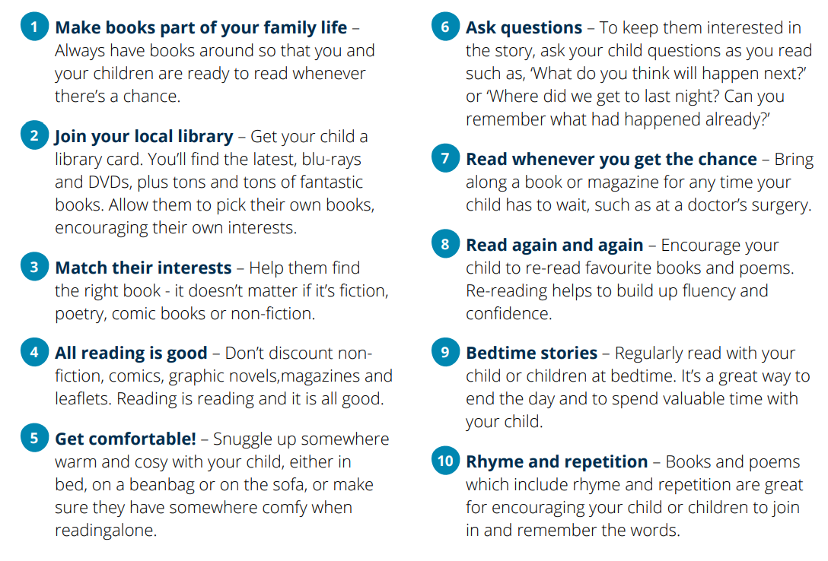
What can you do to help?

Slide 6
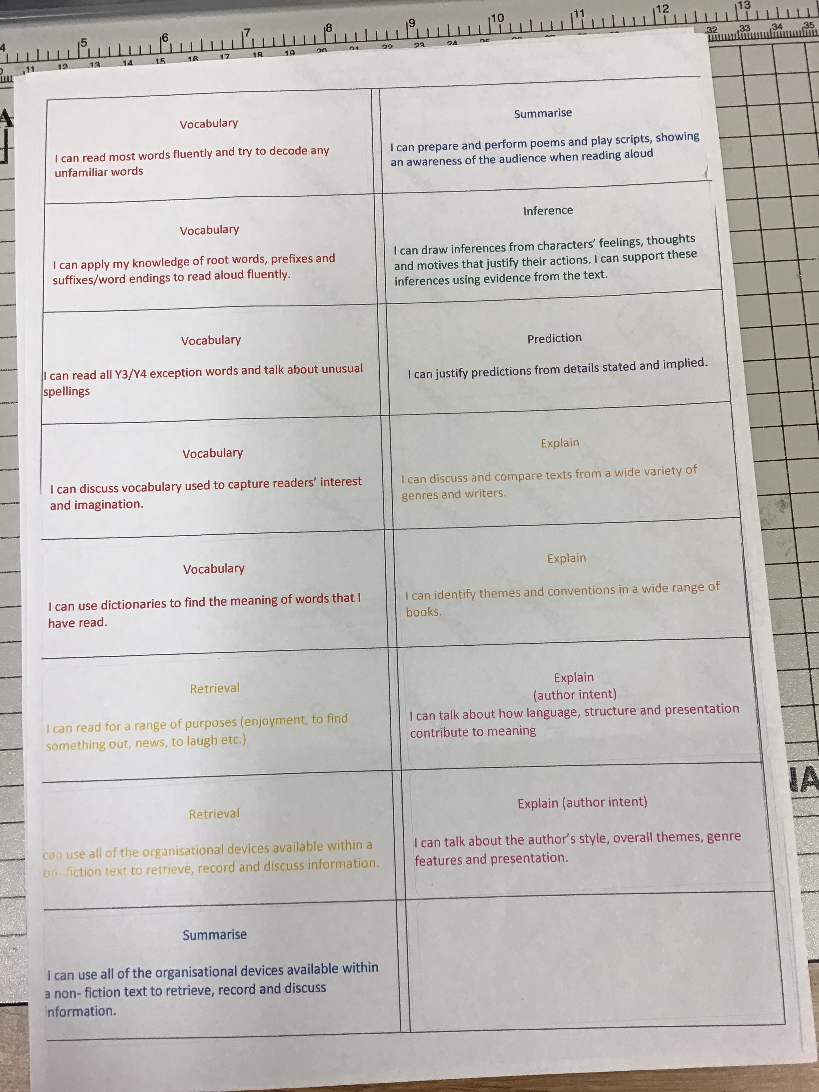
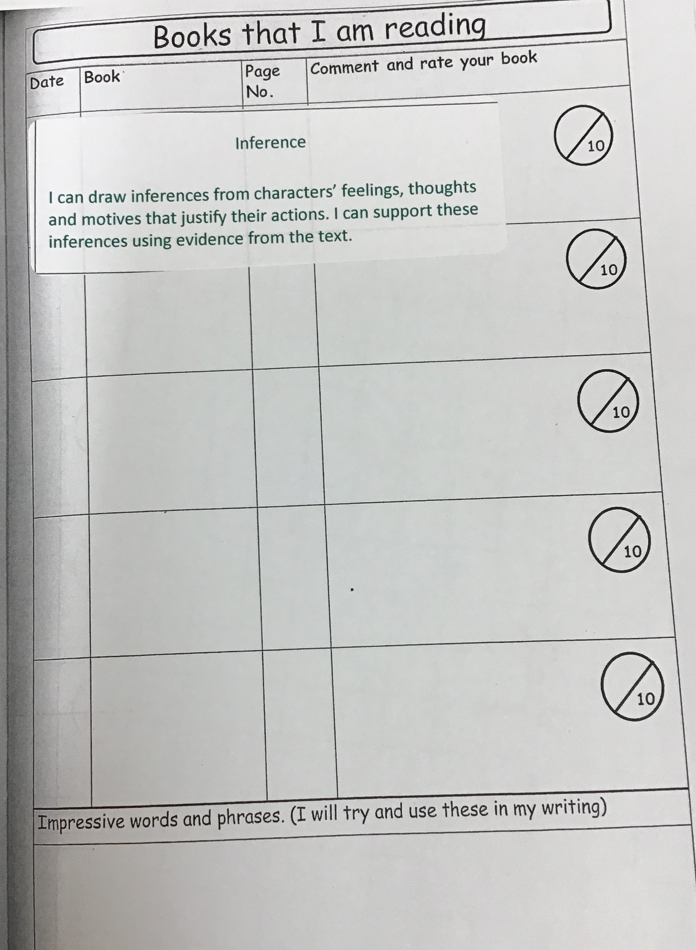

Slide 7
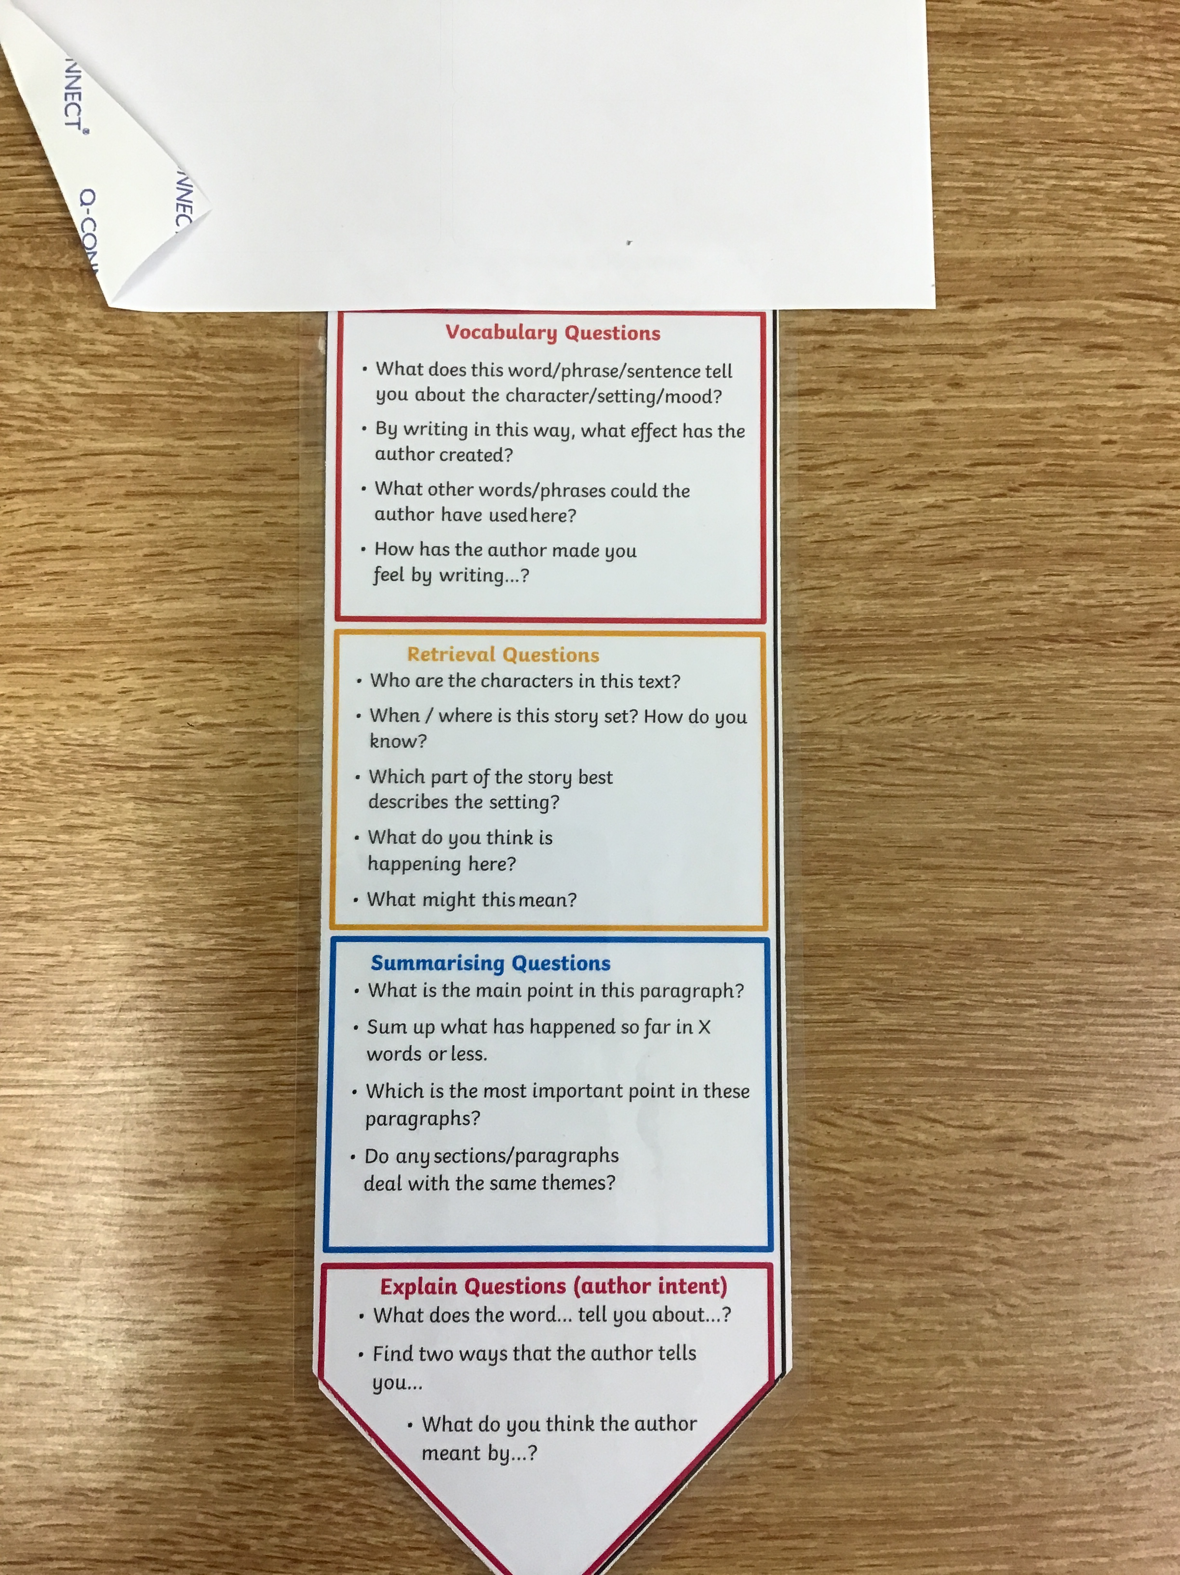
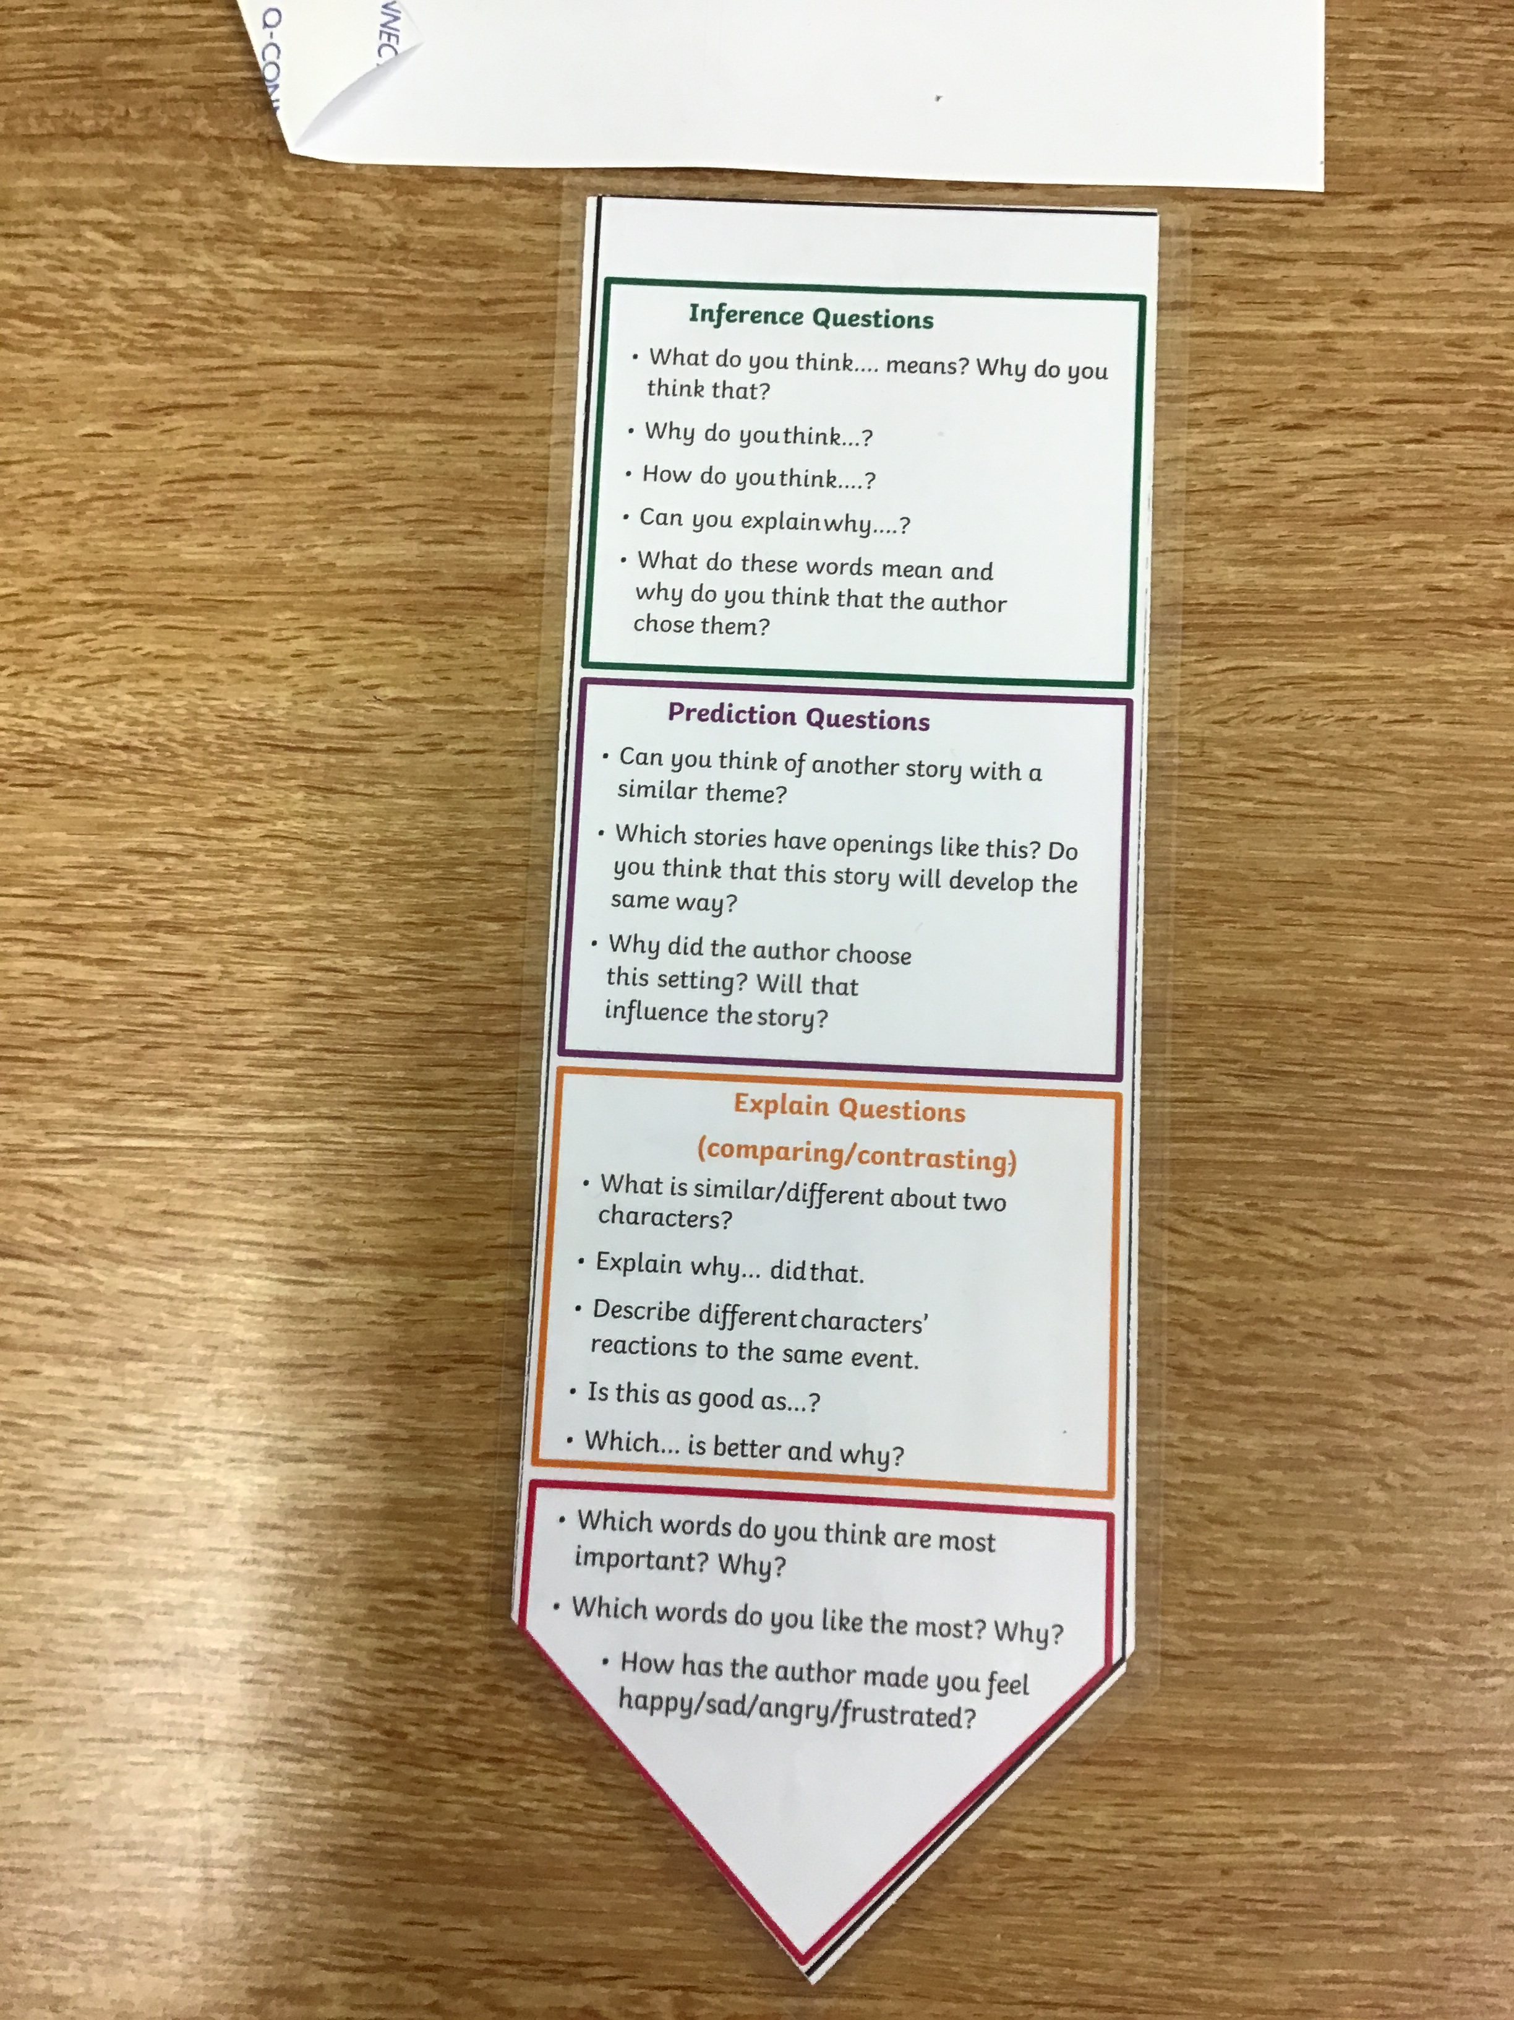

Slide 8
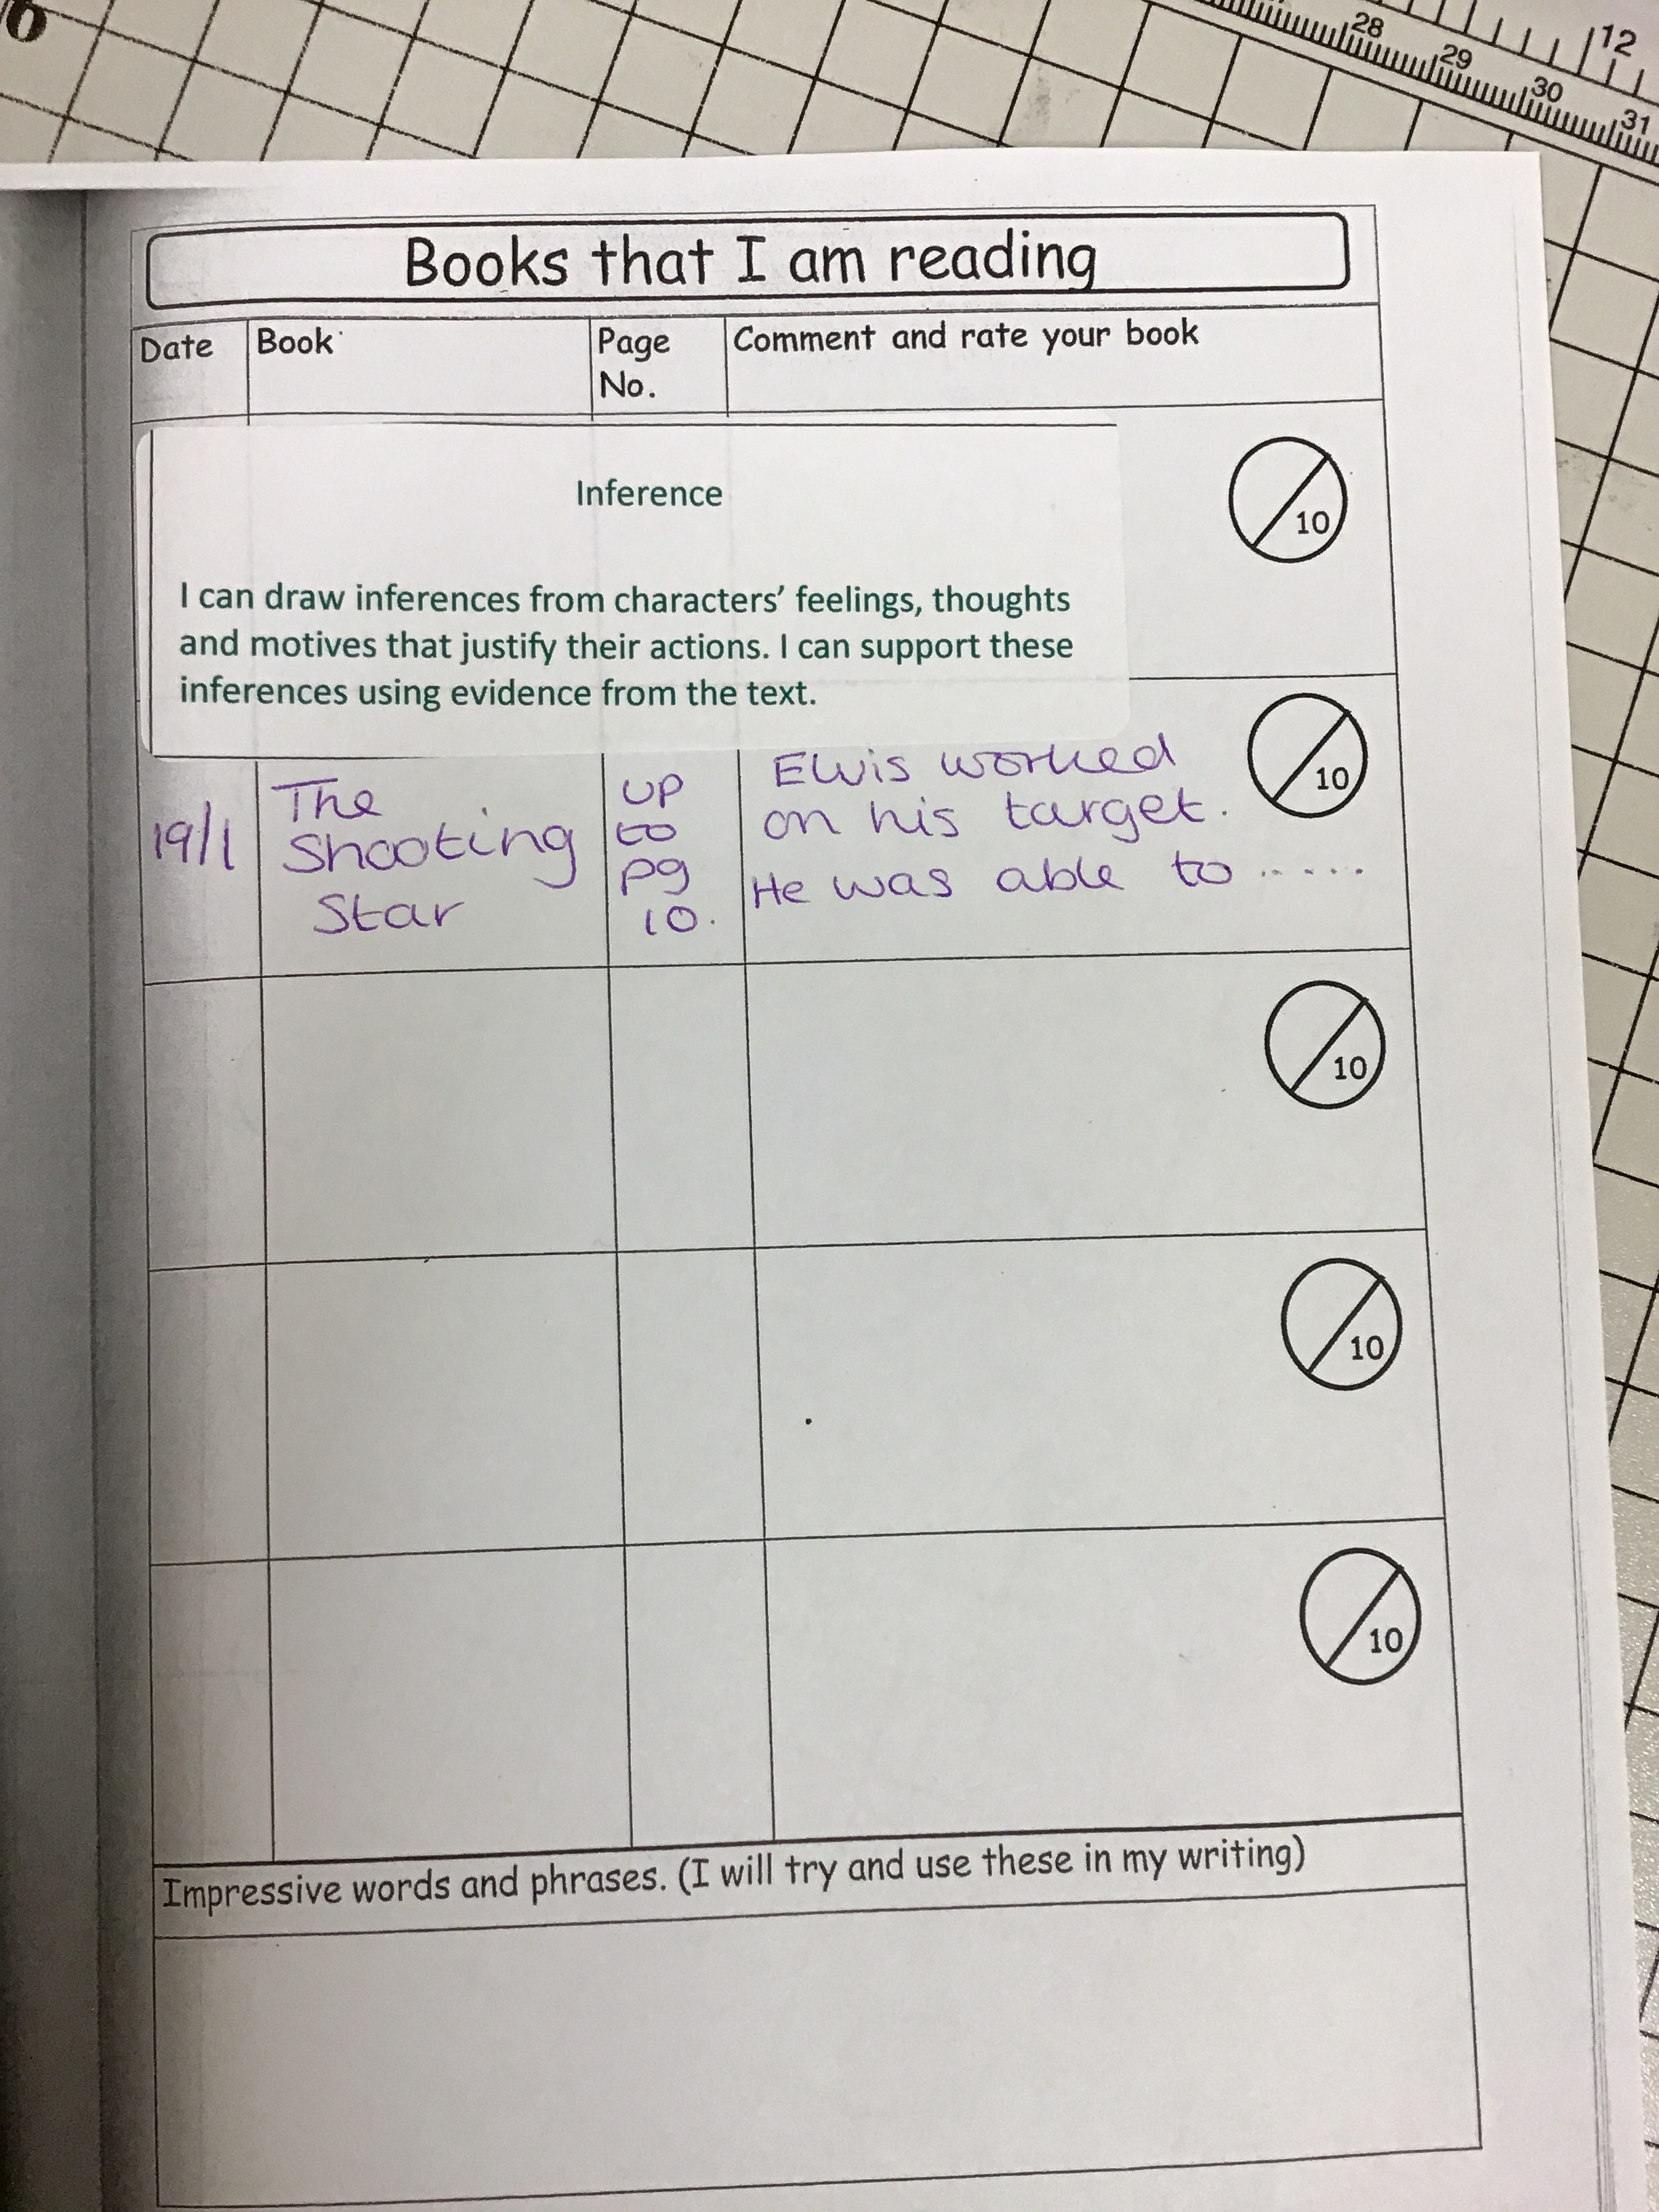
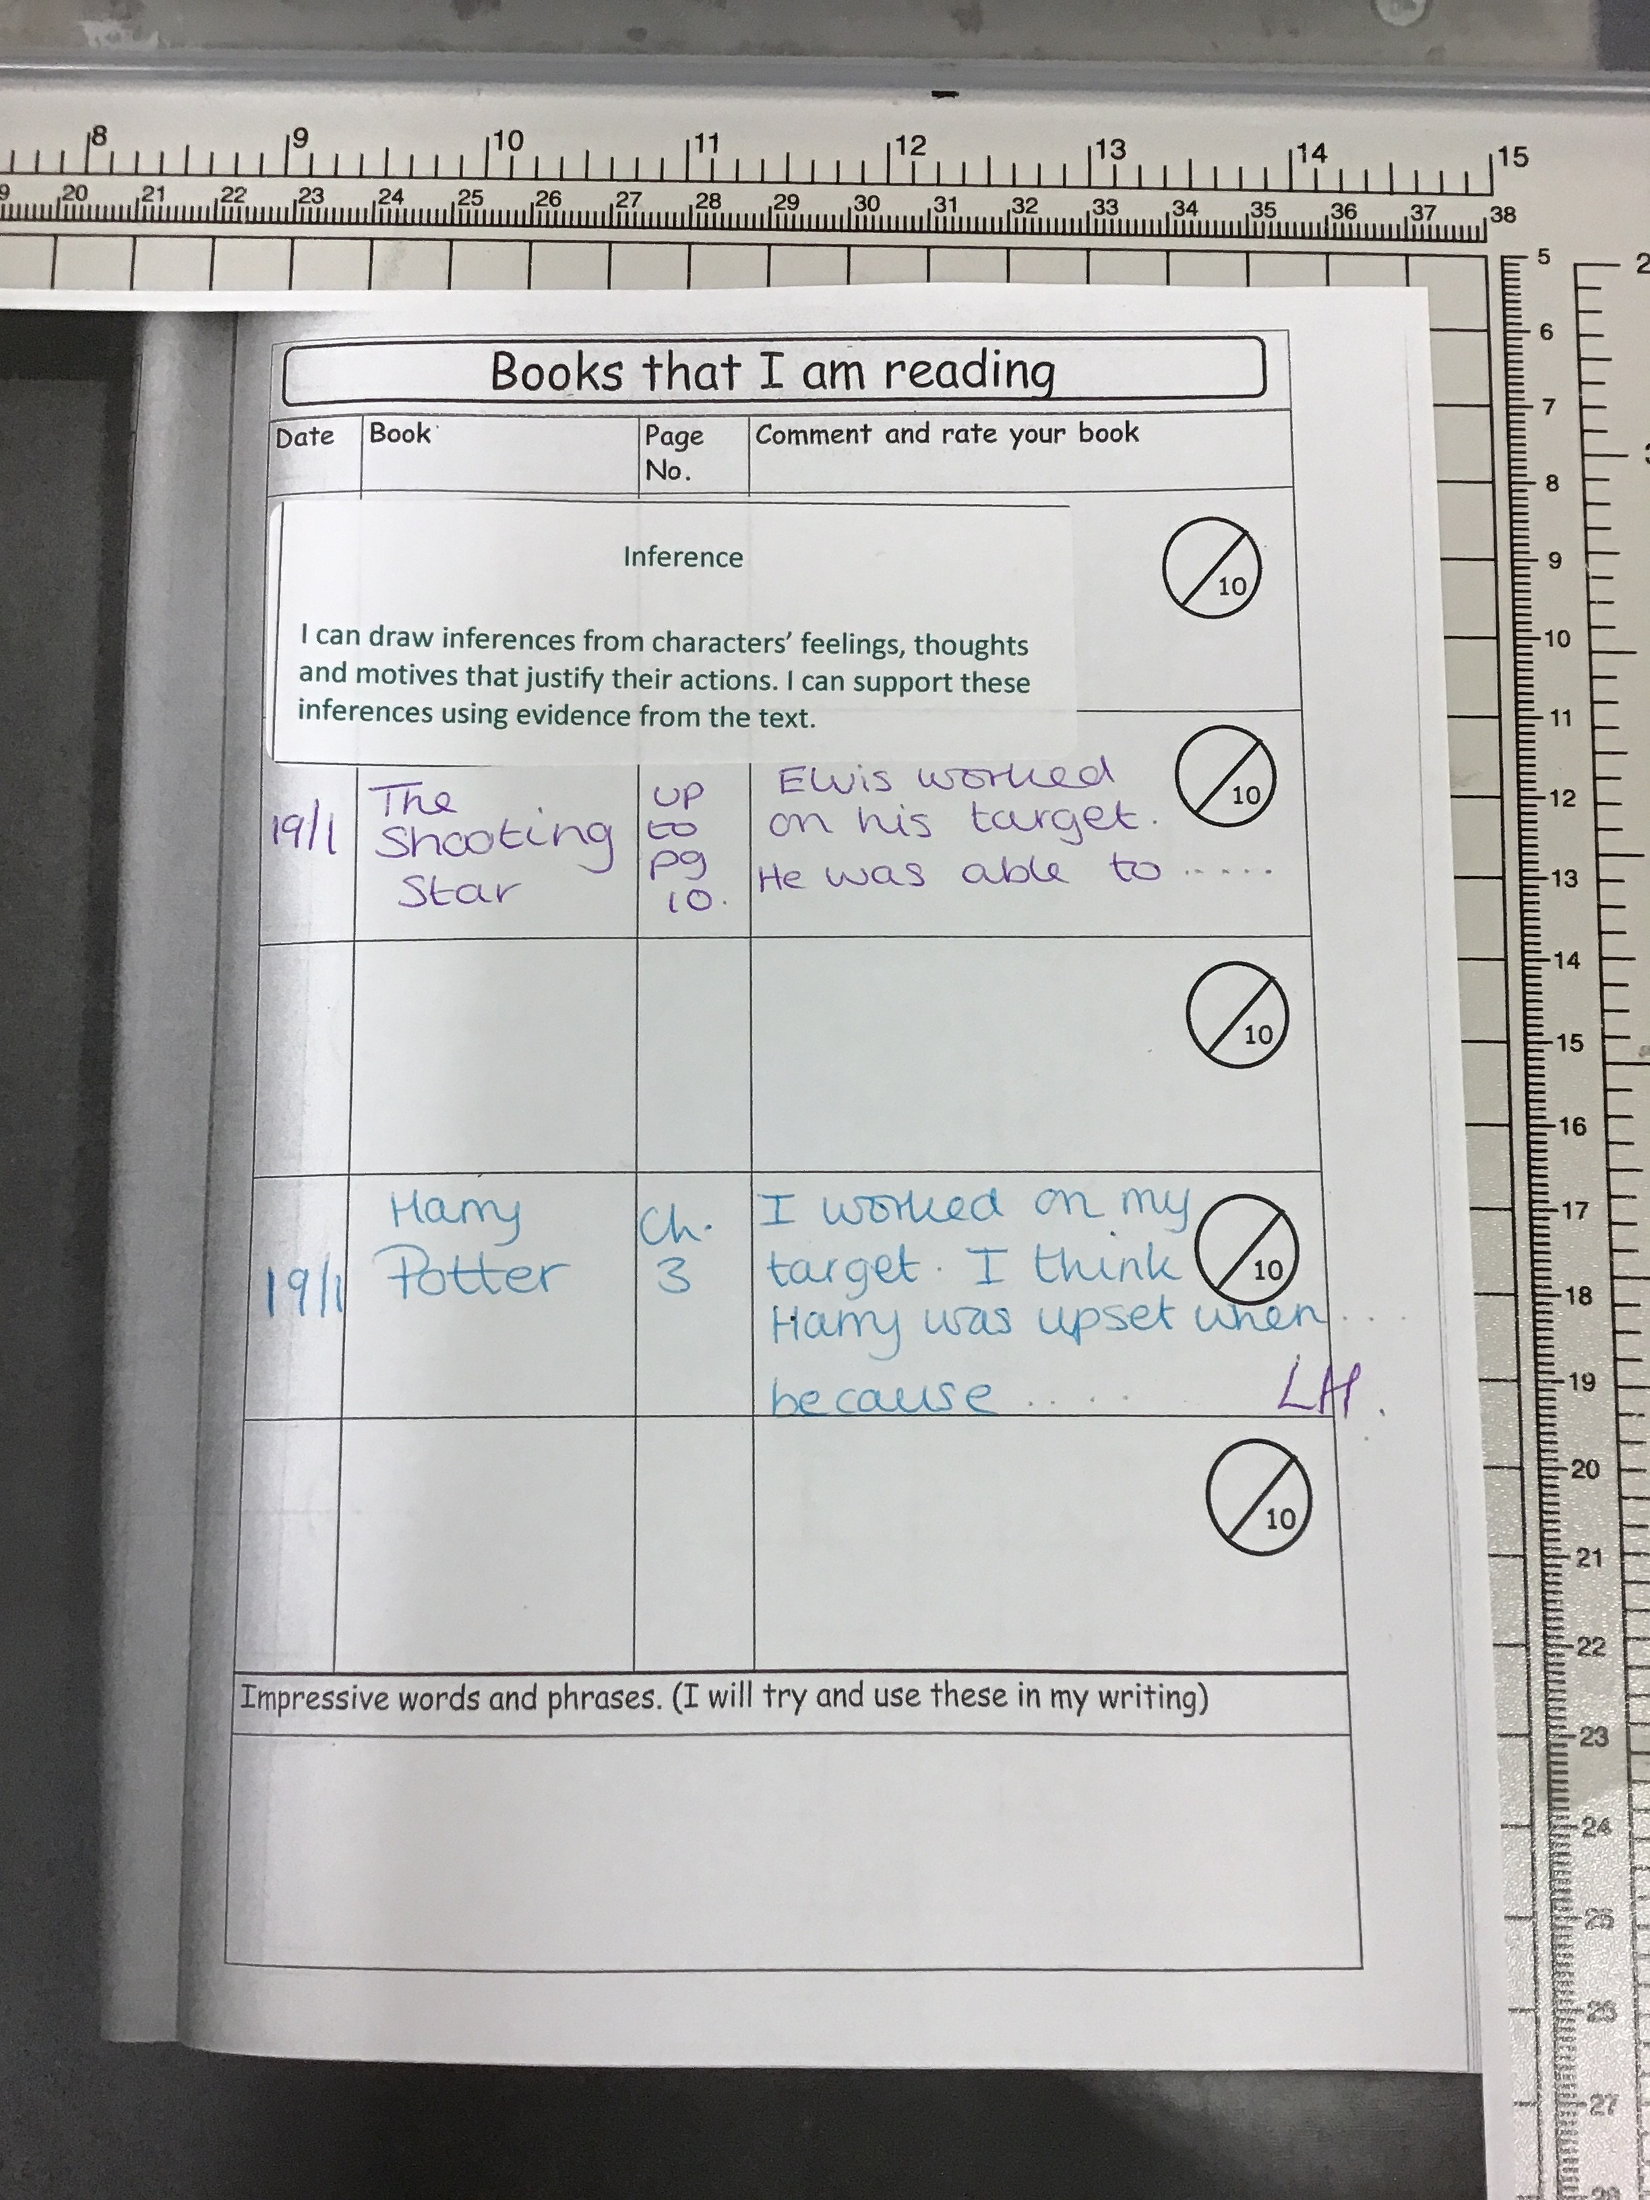
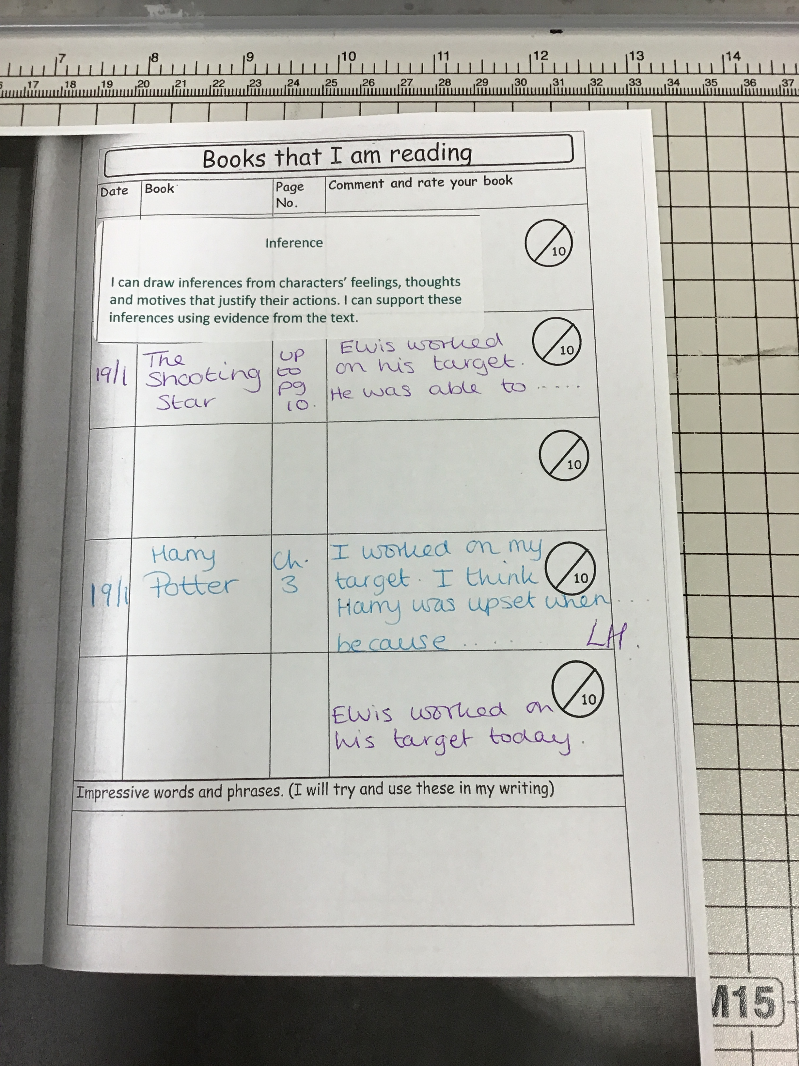
KS1 or if you are writing for them
KS2

Slide 9
Thank you for your support!

